Slide 1



Cache Bank Landing Page
A fictitious Software Developer
Portfolio Piece
1/3/2024 | THABO JAFTA

Slide 2

Get ready for a thrilling journey! In this presentation, I’ll be unveiling a stunning landing page I crafted for ‘Cache Bank’, an imaginative banking solution. You’ll witness the power of HTML5, CSS3, and JavaScript in action, all beautifully styled with the dynamic Tailwind CSS. Stay tuned for an exciting exploration of modern web development!

Slide 3
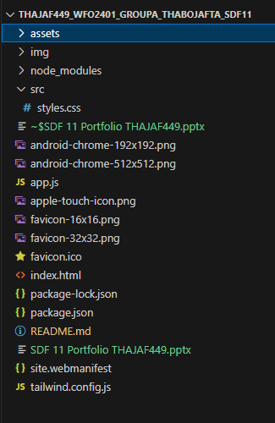
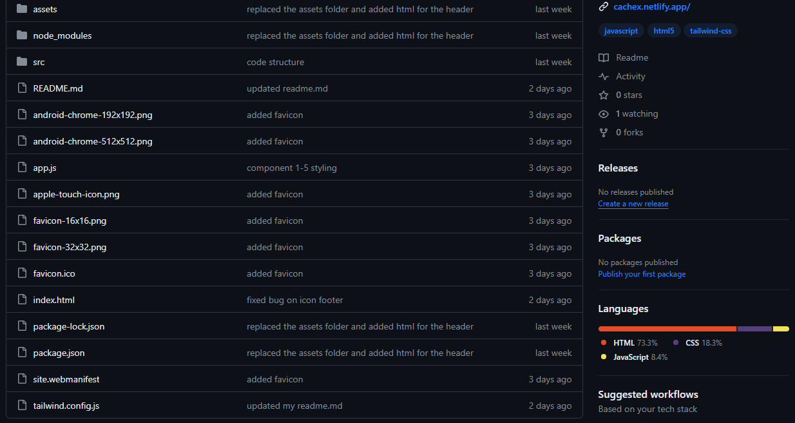
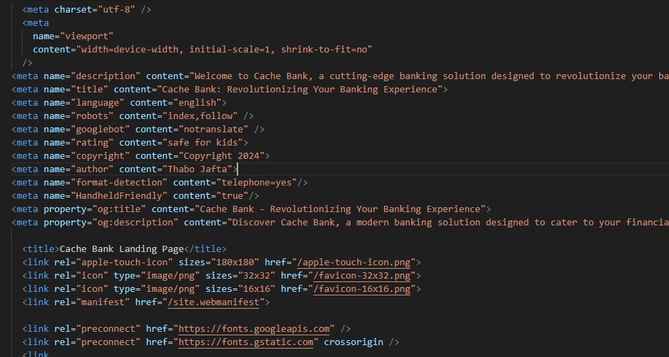
Components setup
1. IDE Setup
1. HTML setup
2. Github Setup
My IDE structure and some of the dependencies
Clone my GitHub Repository and setup Clone GitHub Repo & setup up own GitHub repository for project.up own GitHub repo for the project at hand.
Structure of my HTML and some meta tags

Slide 4
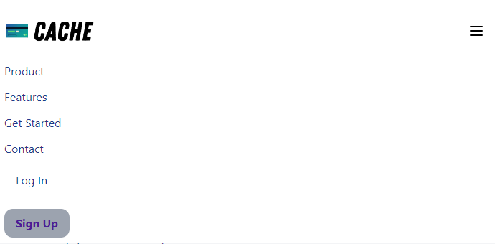
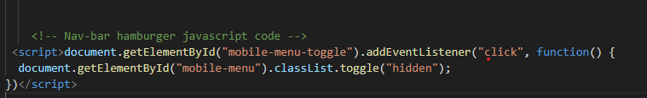
Component 1- Navigation Bar
Mobile First design approach that prioritizes mobile devices during the product design process.
It recognizes the significance of mobile web usage and emphasizes creating an experience tailored specifically for smaller screens.
Web nav
Hamburger Icon and Mobile Menu:
The hamburger icon is displayed on smaller screens (md:hidden).
It has an ID of "mobile-menu-toggle".
The mobile menu (hidden by default) is revealed when the icon is clicked.
The mobile menu contains navigation links (styled similarly to desktop links).
Mobile menu
The code creates a header section with navigation links and a mobile menu (hamburger icon).
It includes a logo, desktop navigation links, buttons for login and sign-up, and a mobile menu toggle.
The mobile menu appears when the hamburger icon is clicked.

Slide 5

Component 2- Hero & Endorsements
It spans the full width (w-full) and has a grid layout with one column by default (grid-cols-1).
On medium screens, it has two columns (md:grid-cols-2), and there’s a gap between columns (md:gap-5).
The section is vertically centered (my-auto) and has additional top and bottom margins (mt-12 mb-8).
Left Column (Text Content):
The left column (col-span-1) contains text content.
It uses flexbox (flex flex-col justify-center) to vertically align its child elements.
The title is “The Clever Place to Keep Your Cache” (styled with large font size and bold text).
The description explains that Cache Bank is designed for software developers, offering cutting-edge financial solutions.
Buttons:
Below the description, there are two buttons:
“Join Cache Now”
“Join Our Discord Server”
Both buttons have consistent styling (green background, white text, rounded corners, hover effect).
Right Column (Image):
The right column (col-span-1) is hidden on small screens (md:flex).
It contains an image (<img>) representing the product.
The image is centered and has rounded corners (rounded-md).

Slide 6
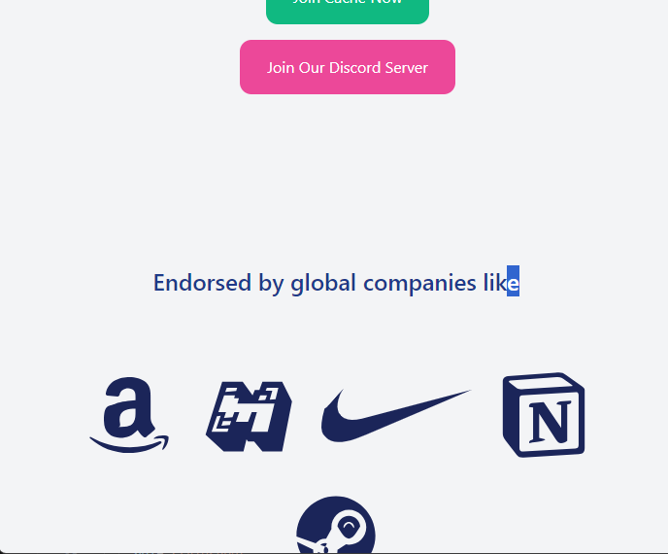
Component 3- Endorsements
Container and Vertical Alignment:
Inside the section, there’s a container with the class "container flex flex-col items-center gap-8 mx-auto my-40".
The container is centered horizontally (mx-auto) and vertically spaced (my-40).
It uses flexbox (flex flex-col items-center) to align its child elements vertically.
The gap-8 adds vertical spacing between child elements.
This section is added to show trustworthy companies to win consumer trust.

Slide 7
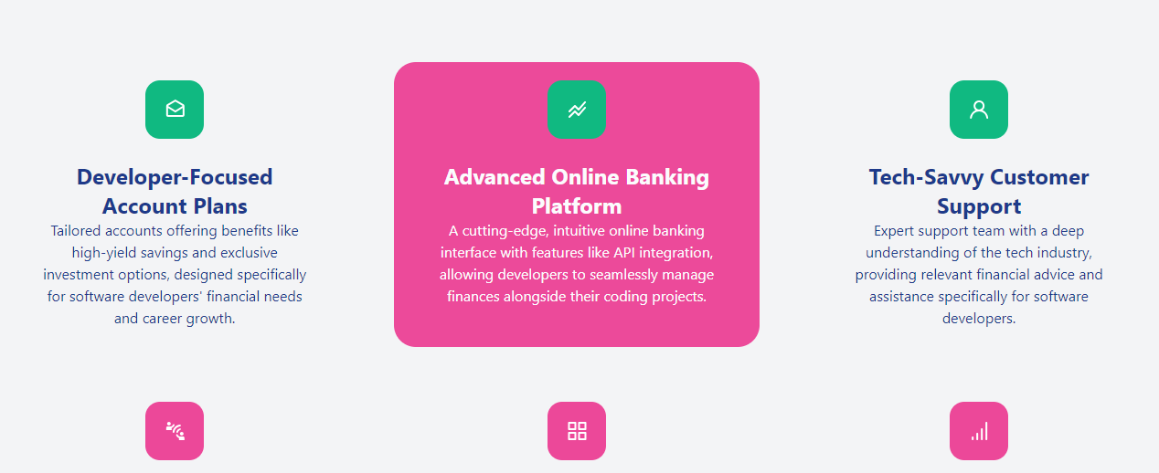
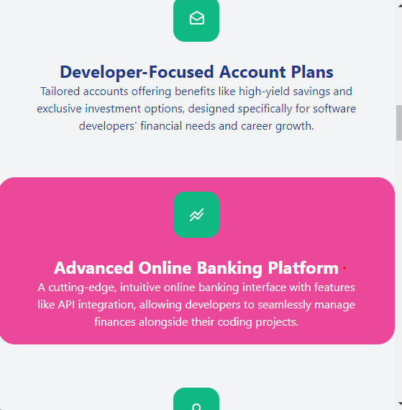
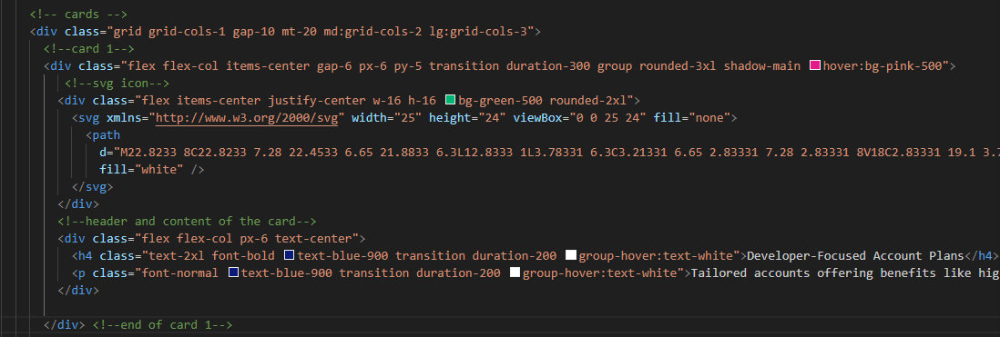
The code creates a grid layout for displaying features or cards.
The grid has different column configurations based on screen size:
One column for small screens.
Two columns for medium screens.
Three columns for large screens.
This responsive design ensures that the grid adapts to different devices.
Card Structure:
Each card within the grid contains:
An SVG icon (representing a feature).
A title (<h4>) and description (<p>).
All elements within the card are organized using flexbox with a column direction.
As the screen size shrinks, the elements stack vertically within each card.
Component 4 – Features
large devices
sm/ md Devices

Slide 8

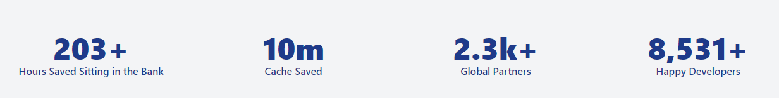
Component 4 cont’d- Statistics and Getting Started Section
Card Grid:
Below the title and description, there’s a grid layout for displaying features or benefits.
The grid has one column by default (grid-cols-1), but on medium screens, it has two columns (md:grid-cols-2), and on large screens, it has three columns (lg:grid-cols-3).
The number is dynamically generated using the countto attribute (e.g., <span id="countto1" countto="250">250</span>).

Slide 9
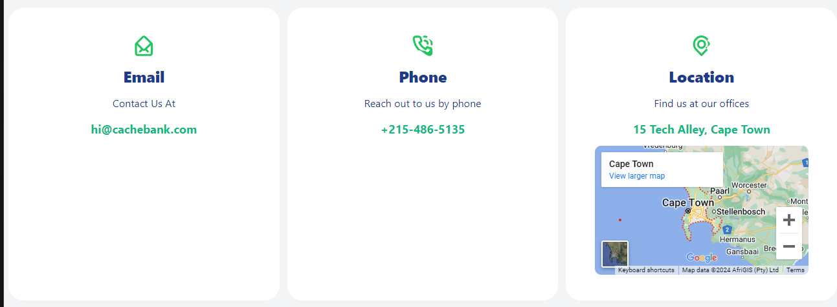
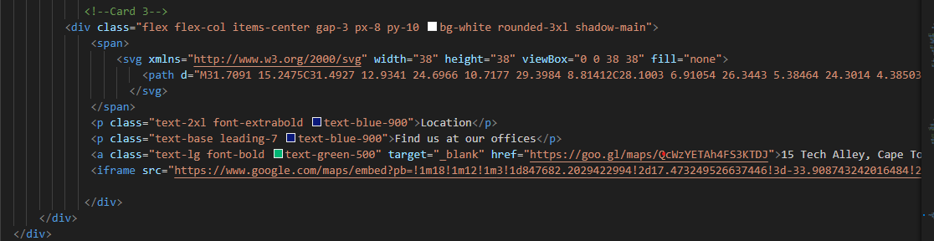
Component 5- Contact & Footer
Google Maps Link:
The anchor (<a>) element contains a clickable link with the text “15 Tech Alley, Cape Town.”
The link opens in a new tab (target="_blank").
The <iframe> element embeds a Google Map directly into the webpage.
The src attribute contains a Google Maps URL with latitude and longitude coordinates.
The map displays the location of “15 Tech Alley, Cape Town.”
The dimensions are set to width="330" and height="200".
Users can interact with the map and view it in full screen.

Slide 10
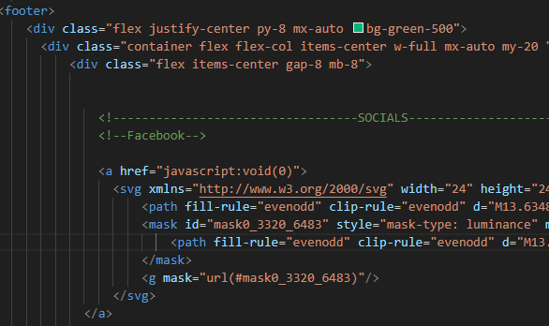

Component 5- Footer
Container and Styling:
The entire footer section is wrapped in a <div> with the class "flex justify-center py-8 mx-auto bg-green-500".
It has a green background (bg-green-500), centered horizontally (justify-center), and vertically spaced (py-8).
The content within this container is centered both horizontally and vertically (items-center).
Social Icons:
There are five social icons (Facebook, Twitter, Instagram, LinkedIn, and GitHub).
Each icon is represented by an <a> element with an href attribute set to the respective social media profile link.
The icons are SVG images with specific dimensions (width="24" and height="24").
They have hover effects (hover:text-gray-500 hover:scale-110) that change the color and scale when hovered over.

Slide 11
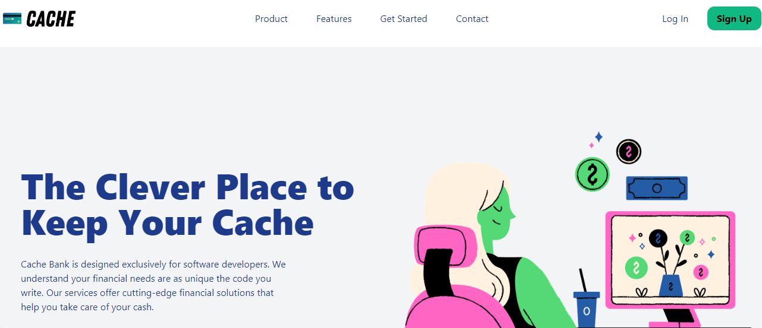
Conclusion
Building this website was a valuable learning journey. It provided a deep understanding of several key concepts:
- Tailwind CSS: The project offered hands-on experience with Tailwind CSS, a utility-first CSS framework, and helped in mastering the use of utility classes for styling.
- Flexbox: The project enhanced my understanding of Flexbox, a CSS layout module, which was used to design flexible responsive layout structures, including the navigation bar and other components.
-CSS Grid: The project facilitated learning of CSS Grid, a powerful tool for creating complex responsive designs, which was used extensively for layout creation across various sections of the website.
During the development of this website, I encountered several challenges that provided valuable learning experiences:
In conclusion, every challenge encountered morphed into an opportunity for professional growth and skill enhancement. This project stands not just as a testament to acquired technical skills but as a narrative of resilience, adaptability, and continuous learning that transcends classroom walls.

